Slide 1
Classification
Chapter 2- part 2

Slide 2
Classification
Classification is a supervised machine learning method where the model tries to predict the correct label of a given input data.
In classification, the model is fully trained using the training data, and then it is evaluated on test data before being used to perform prediction on new unseen data.
The prediction task is a classification when the target variable is discrete such as identification of the underlying sentiment of a piece of text.
When the target variable is continuous such as prediction of the salary of a person given their education degree, previous work experience, geographical location, and level of seniority it is regression.

Slide 3
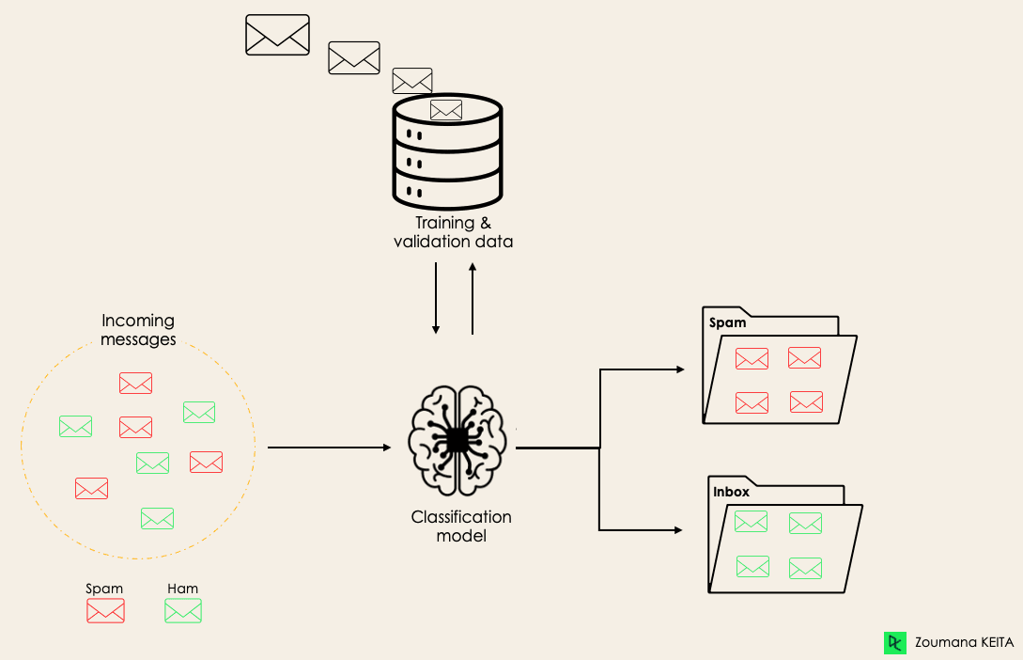
For instance, an algorithm can learn to predict whether a given email is spam or no spam, as illustrated below.

Slide 4
Types of classification
There are four main classification tasks in Machine learning: binary, multi-class, multi-label, and imbalanced classifications.
In a binary classification task, the goal is to classify the input data into two mutually exclusive categories.
The training data in such a situation is labeled in a binary format: true and false; positive and negative; O and 1; spam and not spam, etc. depending on the problem being tackled.
For instance, we might want to detect whether a given image is a truck or a boat.

Slide 5
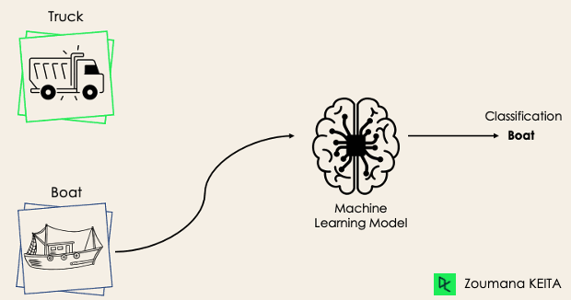
Example

Slide 6
Algorithms for binary classification
Logistic Regression and Support Vector Machines algorithms are natively designed for binary classifications.
However, other algorithms such as K-Nearest Neighbors and Decision Trees can also be used for binary classification.

Slide 7
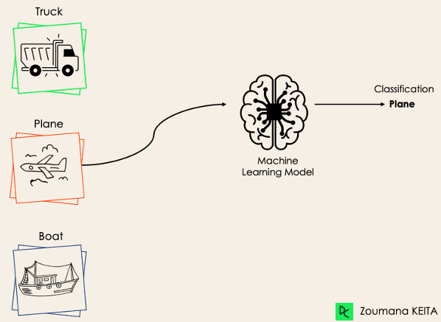
Multi-Class Classification
The multi-class classification, on the other hand, has at least two mutually exclusive class labels, where the goal is to predict to which class a given input example belongs to.
In the following case, the model correctly classified the image to be a plane.

Slide 8
Algorithms for multi-class Classification
Most of the binary classification algorithms can be also used for multi-class classification.
These algorithms include but are not limited to:
Random Forest, Naive Bayes , K-Nearest Neighbors ,Gradient Boosting , SVM, Logistic Regression.
SVM and Logistic Regression do not support multi-class classification by default.
However, we can apply binary transformation approaches such as one-versus-one and one-versus-all to adapt native binary classification algorithms for multi-class classification tasks.

Slide 9
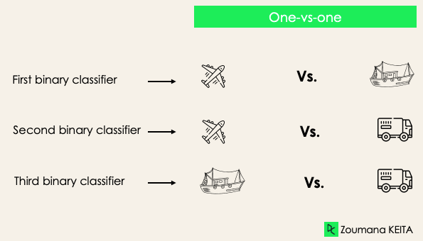
One-versus-one
This strategy trains as many classifiers as there are pairs of labels. It works best for SVM and other kernel-based algorithms.
If we have a 3-class classification, we will have three pairs of labels, thus three classifiers, as shown below.

Slide 10
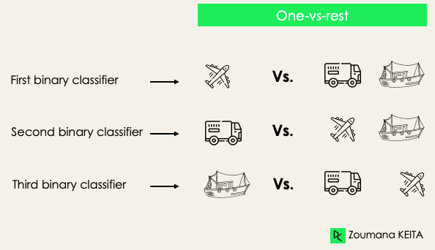
One-versus-rest
One-versus-rest: at this stage, we start by considering each label as an independent label and consider the rest combined as only one label. With 3-classes, we will have three classifiers.
In general, for N labels, we will have N binary classifiers.

Slide 11
Multi-Label Classification
In multi-label classification tasks, we try to predict 0 or more classes for each input example.
In this case, there is no mutual exclusion because the input example can have more than one label.
Such a scenario can be observed in different domains, such as auto-tagging in Natural Language Processing, where a given text can contain multiple topics.
Similarly to computer vision, an image can contain multiple objects, as illustrated below: the model predicted that the image contains: a plane, a boat, a truck, and a dog.

Slide 12
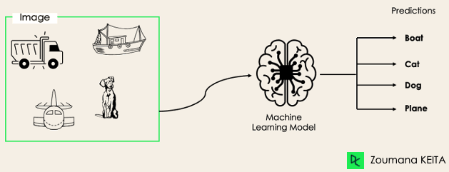
Multi-label example

Slide 13
Con’t…
It is not possible to use multi-class or binary classification models to perform multi-label classification.
However, most algorithms used for those standard classification tasks have their specialized versions for multi-label classification.
We can use:
Multi-label Decision Trees
Multi-label Gradient Boosting
Multi-label Random Forests

Slide 14
Imbalanced Classification
For the imbalanced classification, the number of examples is unevenly distributed in each class, meaning that we can have more of one class than the others in the training data.
Let’s consider the following 3-class classification scenario where the training data contains: 60% of trucks, 25% of planes, and 15% of boats.
Using conventional predictive models such as Decision Trees, LR, etc. could not be effective here, because they might be biased toward predicting the class with the highest number of observations, and considering those with fewer numbers as noise.
We can use multiple approaches to tackle the imbalance problem in a dataset.

Slide 15
KNN
K-nearest neighbor is a supervised lazy learner algorithm used in machine learning because it does not build a model during training.
Instead, KNN simply stores all the training data and makes predictions by comparing new data points to the stored dataset.
Since no actual model is built, the training phase is fast, but predictions can be slow.
After storing its training data, a KNN algorithm compares it with test data and measures the degree of similarity between these data sets.

Slide 16
Con’t…
The algorithm then stores all instances that correspond with the training data.
Next, the algorithm attempts to predict the likelihood that future data might correspond to the dataset it compiled.
KNN works by finding the distances between a query and all the examples in the data, selecting the specified number of examples (K) closest to the query, then votes for the most frequent label (in the case of classification) or averages the labels (in the case of regression)
Choosing the right K for a set of data is done by trying several Ks and picking the one that works best.

Slide 17
Pros and cons of KNN
Advantages :
Easy and simple machine learning model.
Few hyper-parameters to tune.
Disadvantages :
k should be wisely selected.
Large computation cost during runtime if sample size is large.
Proper scaling should be provided for fair treatment among features.

Slide 18
Applications of KNN classifier
Text categorization: Classifying documents into predefined topics
Image classification: Identifying objects or scenes in images
Customer segmentation: Grouping customers based on purchasing behavior

Slide 19
NAÏVE BEYES
It is a classification technique based on Bayes’ Theorem with an independence assumption among predictors.
Naive Bayes classifier assumes that the presence of a particular feature in a class is unrelated to the presence of any other feature.
Naïve Bayes are simple probabilistic classifiers that apply Bayes’ theorem.
This theorem is based on the probability of a hypothesis, given the data and some prior knowledge.
The naive Bayes classifier assumes that all features in the input data are independent of each other, which is often not true in real-world scenarios.

Slide 20
Con’t…
However, despite this simplifying assumption, the naive Bayes classifier is widely used because of its efficiency and good performance in many real-world applications.
It involves using a kernel function to estimate the probability density function of the input data, allowing the classifier to improve its performance in complex scenarios where the data distribution is not well-defined.
As a result, the naive Bayes classifier is a powerful tool in machine learning, particularly in text classification, spam filtering, and sentiment analysis, among others.

Slide 21
Pros and cons of naïve bayes
Advantages:
Easy to implement and computationally efficient.
Effective in cases with a large number of features.
Performs well even with limited training data.
It performs well in the presence of categorical features.
Disadvantages:
Assumes that features are independent, which may not always hold in real-world data.
Can be influenced by irrelevant attributes.
May assign zero probability to unseen events, leading to poor generalization.

Slide 22
Applications of Naive Bayes Classifier
Spam Email Filtering: Classifies emails as spam or non-spam based on features.
Text Classification: Used in sentiment analysis, document categorization, and topic classification.
Medical Diagnosis: Helps in predicting the likelihood of a disease based on symptoms.
Credit Scoring: Evaluates creditworthiness of individuals for loan approval.
Weather Prediction: Classifies weather conditions based on various factors.

Slide 23
Logistic regression
Logistic regression is the right algorithm to start with classification algorithms.
Even though, the name ‘Regression’ comes up, it is not a regression model, but a classification model.
It uses a logistic function to frame binary output model.
The output of the logistic regression will be a probability (0≤x≤1), and can be used to predict the binary 0 or 1 as the output ( if x<0.5, output= 0, else output=1).
It also calculates the linear output, followed by a stashing function over the regression output.
Sigmoid function is the frequently used logistic function.

Slide 24
Pros and cons of logistic regression
Advantages :
Easy, fast and simple classification method.
Can be used for multiclass classifications also.
Loss function is always convex.
Disadvantages :
Can’t be applied on non-linear classification problems.
Proper selection of features is required.
Good signal to noise ratio is expected.
Co-linearity and outliers decrease the accuracy of LR model.

Slide 25
Applications of LR
Credit Scoring in Finance: it helps banks predict loan defaults with high accuracy and making safer lending decisions, minimizing financial risks.
Disease Prediction in Healthcare: it enhances the precision of blood tests, aiding in the early detection of gene-related diseases.
Text Classification in Natural Language Processing: In natural language processing, logistic regression is invaluable.
It shines in tasks like toxic speech detection, topic classification, and email sorting. It's also adept at converting PDF and OCR text into usable formats.
OCR stands for "Optical Character Recognition." It is a technology that recognizes text within a digital image.

Slide 26
Con’t…
Customer Churn Prediction in Business: Businesses, especially in telecom and subscription services, employ logistic regression for customer churn prediction.
For instance, Booking.com uses it to forecast user behavior, like travel date changes, without needing specific user data.

Slide 27
Decision tree
It is a classification algorithm that uses a process of division to split data into increasingly specific categories.
It's called a decision tree because the classification process resembles a tree's branches when represented graphically.
The algorithm works on a supervised model and requires high-quality data to produce good results.
A decision tree splits data into increasingly specific groups based on key features.
It uses if-then rules to divide the dataset, resembling the branching structure of a tree.
At each "branch," the algorithm decides based on the most important feature until it arrives at a decision.

Slide 28
Structure of a Decision Tree
Root Node: Represents the entire dataset and the initial decision to be made.
Internal Nodes: Represent decisions or tests on attributes. Each internal node has one or more branches.
Branches: Represent the outcome of a decision or test, leading to another node.
Leaf Nodes: Represent the final decision or prediction. No further splits occur at these nodes.

Slide 29
Pros and cons of decision tree
Advantages:
Simplicity and Interpretability: Decision trees are easy to understand and interpret. The visual representation closely mirrors human decision-making processes.
Versatility: Can be used for both classification and regression tasks.
No Need for Feature Scaling: Decision trees do not require normalization or scaling of the data.
Handles Non-linear Relationships: Capable of capturing non-linear relationships between features and target variables.
Disadvantages:
Over-fitting: Decision trees can easily over-fit the training data, especially if they are deep with many nodes.
Instability: Small variations in the data can result in a completely different tree being generated.
Bias towards Features with More Levels: Features with more levels can dominate the tree structure.

Slide 30
Applications of decision tree
Business Decision Making: Used in strategic planning and resource allocation.
Healthcare: Assists in diagnosing diseases and suggesting treatment plans.
Finance: Helps in credit scoring and risk assessment.
Marketing: Used to segment customers and predict customer behavior.

Slide 31
Random forest
Random forest is an ensemble classifier, i.e. a combining classifier that uses and combines many decision tree classifiers.
Ensemble is usually done using the concept of bagging with different feature sets.
The reason for using large number of trees in random forest is to train the trees enough such that contribution from each feature comes in a number of models.
After the random forest is generated by combining the trees, majority vote is applied to combine the output of the different trees

Slide 32
Con’t…
In random forest each tree is constructed using a different bootstrap sample from the original data.
The samples left out of the bootstrap and not used in the construction of the i-th tree can be used to measure the performance of the model.
At the end of the run, predictions for each such sample evaluated each time are tallied, and the final prediction for that sample is obtained by taking a vote.
The total error rate of predictions for such samples is termed as out-of-bag (OOB) error rate.

Slide 33
Pros and cons of Random forest
Advantages:
Efficiency: It runs efficiently on large and expansive data sets.
Robustness: It has a robust method for estimating missing data and maintains precision when a large proportion of the data is absent.
Balancing: It has powerful techniques for balancing errors in a class population of unbalanced data sets.
Can be used again: Generated forests can be saved for future use on other data.
Random forest algorithm can be used to solve both classification and regression problems.

Slide 34
Con’t…
Dis-Advantages:
Complexity: This model, because it combines a number of decision tree models, is not as easy to understand as a decision tree model.
Expensive: It is computationally much more expensive than a simple model like decision tree.

Slide 35
Applications of random forest
Banking Industry: Credit Card Fraud Detection, Customer Segmentation, Predicting Loan Defaults on LendingClub.com
Healthcare and Medicine: Cardiovascular Disease Prediction, Diabetes Prediction, Breast Cancer Prediction
Stock Market: Stock Market Prediction, Stock Market Sentiment Analysis, Bitcoin Price Detection
E-Commerce: Product recommendation, Price Optimization, Search Ranking

Slide 36
Support vector machine (SVM)
SVM a simple algorithm used for classification or regression activities.
They work by finding hyper-planes within a data distribution, which you can visualize as a line separating two different classes of data.
There are often many hyper-planes capable of separating the data, and the algorithm can select the optimum line of separation.
In the SVM model, the optimum hyper-plane is the dividing line that offers the greatest margin between the different classes.
If the data is not linearly separable in 2 dimensions, SVMs can project the data into higher dimensions using a technique called the kernel trick, allows them to create a hyper-plane in this transformed space.
This makes SVMs good at handling complex, non-linearly separable data.

Slide 37
Pros and cons of SVM
Advantages:
SVM can be used for both classification and regression.
It is robust, i.e. not much impacted by data with noise or outliers.
The prediction results using this model are very promising.
Disadvantages:
SVM is applicable only for binary classification, i.e. when there are only two classes in the problem domain.
The SVM model is very complex – almost like a black box when it deals with a high-dimensional data set.
Hence, it is very difficult and close to impossible to understand the model in such cases.
It is slow for a large dataset, i.e. a data set with either a large number of features or a large number of instances.
It is quite memory-intensive

Slide 38
Applications of SVM
Face detection – classify parts of the image as a face and non-face
Text and hypertext categorization –They use training data to classify documents into different categories.
It categorizes on the basis of the score generated and then compares with the threshold value.
Classification of images – Use of SVMs provides better search accuracy for image classification
Bioinformatics – It includes protein classification and cancer classification. Can identify the classification of genes, patients on the basis of genes and other biological problems.
Handwriting recognition – We use SVMs to recognize handwritten characters used widely.

Slide 39
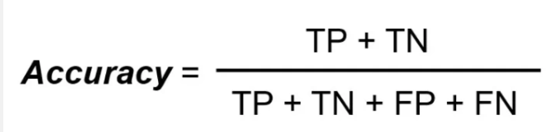
Evaluation metrics
There are many ways for measuring classification performance. Accuracy, confusion matrix, precision, f1 score and recall are some of the most popular metrics.
Accuracy
Accuracy simply measures how often the classifier correctly predicts.
We can define accuracy as the ratio of the number of correct predictions and the total number of predictions

Slide 40


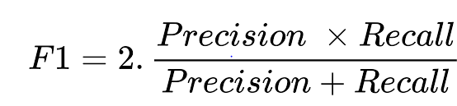
Evaluation metrics
Precision: The proportion of true positive predictions among all positive predictions.
Recall : The proportion of true positives among all actual positive instances.
F1 Score: is the harmonic mean of precision and recall.

Slide 41
Thanks

